Slide 1
8th Grade English 2016-17
Mrs. Cox

Slide 2
Disclosure Document
Due next time
First assignment, so don’t start the year off with a bad grade!

Slide 3
Class Website
http://mrscoxenglishcorner.weebly.com/
This website will have all assignments on it. If you are ever absent or lose an assignment and it is due the next day, you can find it here.
This website can be found in two places:
Disclosure Document
School Website

Slide 4
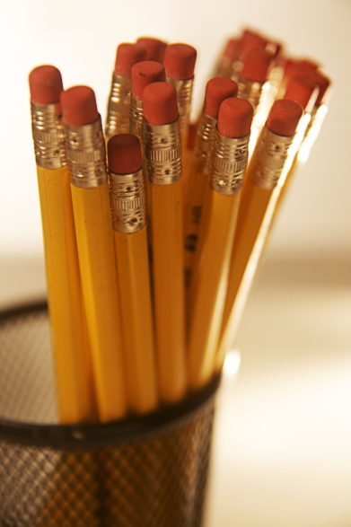

Materials You’ll Need
Needed Daily
Paper, pen, and/or pencil
100 count 3x3 Sticky Notes
3 ring binder with pockets with 3 dividers
  Notes
  Caught’ya Sentences
  Homework
School Planner
Silent Reading Book
Composition Notebook (please no spiral bound). Only to be used for this class

Slide 5
Absences and Tardies
You’re responsible for coming to class.
If you miss, you’re responsible for getting the work you missed. Absences DO NOT excuse you from doing the work. I give assignments to help you learn.
Be in your seat with all the materials when the bell rings.
Unexcused absences and tardies affect your participation grade.

Slide 6
Late Work & Make-Up Work
2 late work passes a term (in Skyward).
No other late work will be accepted.
If you are absent, check the class website.
When absent the day an assignment is given, you have one week from your return to turn it in.
When absent the day an assignment is due but you were in attendance the day it was assigned, it is due the day you return.

Slide 7
No Name Papers
As soon as you get an assignment/paper/etc, the first thing you should do is put your name on it. Why?
If you do turn in your paper without your name, it can be found on the Wall of Shame (shameful because you are in 8th grade and forgot to put your name on your paper….GASP!!!)
If they are turned in on-time, you DO NOT need to use a late pass on them.

Slide 8
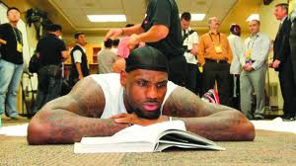
Homework-Reading:
Reading is an important aspect of learning. Students will be required to read 7 books a term. Reading logs will be turned in at the end of each term and will NOT be accepted without a parent/guardian’s signature.

Slide 9
Homework-Writing:
We will be doing a lot of writing in this class. Be prepared to write. This is an English class, so we will be writing.
Because of the amount of reading, I don’t often give homework. However, if you waste time in class and don’t finish, then you will be expected to take it home and therefore, it becomes “homework.”

Slide 10
Citizenship and Participation
Citizenship grades are given based on attendance, participation, and class behavior. Office referrals result in a full grade drop in citizenship.
Participation points are give based on attendance, preparation, tardies, truancies, and following class rules.

Slide 11
Extra Credit
I will NOT allow students to turn in any extra credit if they have any missing assignments.
Any unused late work passes (I do this for you!)
Donate 2 grade level appropriate books to the class library
3% extra credit allowed each term
  Extra credit will NOT be entered until the end of the term.

Slide 12
Grading Policy
Weighted Scale
Participation | 10%
Reading | 10%
Homework/Projects | 80%
Grading Scale
 | A=94-100% | A-=90-93%
B+=87-89% | B=83-86% | B-=80-82%
C+=77-79% | C=73-76% | C-=70-72%
D+=67-69% | D=63-66% | D-=60-62%
F=0-59%

Slide 13
If you Fail
At the beginning of the next term, you will be stamped for English to get your grade up.
I will stamp you during the term for ANY missing assignments.
You will also work with Peer Mentors on missing assignments.

Slide 14
Plagiarism: If you don’t give proper credit when citing sources, you will be asked to redo the assignment. Until it is completed correctly, you will receive a “0”.
Peer Editing: This is an important part of the writing process. It helps you as a writer to see examples of others writing and to act as an “editor.” It also allows others to give you feedback on what readers want to see and find errors your teacher doesn’t want to see.

Slide 15



Novels We’re Reading
Prisoner B-3087 by Alan Gratz
Ender’s Game by Orson Scott Card
How They Croaked by Georgia Bragg

Slide 16
Classroom Rules
This classroom is a NO WHINING ZONE.
  Get it out now.
Have respect
  For yourself by being the best student you can be
  For your classmates by letting them be the best student they can be
  For me as your teacher to be the best teacher I can be
  For the school

Slide 17
Classroom Rules Continued
Respect Yourself: Be the best student YOU can be
  What does this look like?
    Show up on time.
    Be prepared with all your classroom materials every class period.
    Accept responsibility for your own actions

Slide 18
Classroom Rules Continued
Be an ENGAGED learner
  What does this look like?
    Pay attention (be alert, tracking with your eyes, not sleeping or have your head down on your desk.
    Take Notes/Listen (as opposed to chatting or engaging in off-task behavior)
    Asking questions (should be relevant to the topic or task)
    Respond to questions (whether this is whole group, small group, for corners, or Socratic Seminar)
    Read critically (this means with a pen in hand and ready to mark up your paper)

Slide 19
Classroom Rules Continued
Respect your Classmates: Let them be the best students THEY can be
  What does this look like?
    No stealing books, pencils, paper, or any other student’s property.
    Don’t write on or crumple another student’s assignment.
    No discriminating or bullying (We want this to be a safe zone classroom)
    Don’t distract them during class instruction.
    Don’t distract them while they are working.
    No swearing or foul language.

Slide 20
Classroom Rules Continued
Respect for the teacher: Let Mrs. Cox be the best teacher SHE can be.
  What does this look like?
    Don’t talk while she is talking.
    Don’t ask questions or make comments that are off task or off topic.
    Don’t mess with things hanging in the classroom: posters, assignments, etc.

Slide 21
Classroom Rules Continued
Respect for the school.
  What does this look like?
    Don’t vandalize property: bathrooms, walls, desks, books, etc.
    Pick up after yourself: no garbage left on the floor, sinks, desks/tables, etc.
    No swearing or foul language.
    Don’t rip down posters or assignments on the walls in the common areas (halls, triangle, or cafeteria).

Slide 22

Classroom Rules
NO ELECTRONIC DEVICES. This is a school rule. If I see it, it will be confiscated and taken to the office. Sometimes if I’m in a good mood I will give it back, however, it will be reported to the office and put on your “track record.”

Slide 23
Food, Drink, & Gum
Food is allowed until I am left with the clean-up. If you cannot find the garbage can, you cannot have food.
Drinks with twist on lids are allowed as long as you throw empty bottles away and don’t leave them in the classroom. IT IS NOT PART OF MY JOB TO CLEAN UP AFTER YOU. If you leave garbage in the classroom, you cause EVERYONE in the class to lose this privilege
Gum is allowed. You are in 8th grade so you know how to go to the garbage and spit it out. Again, if I find you putting chewed gum anywhere other than the garbage can, you cause everyone in the class to lose the privilege to chew gum.

Slide 24
Classroom Library
You can check-out books from the library ONLY if you actually plan on taking that book home and pursue reading it.
Use the check-out form.
Show it to Mrs. Cox when you check it in.
If you are not prepared with a book for the day, you will annotate. Something I am going to teach you next week.

Slide 25
Classroom Temperature
The room will ALWAYS be kept at a cooler temperature (unless the ac/heater breaks). This means you should be prepared with a jacket.

Slide 26
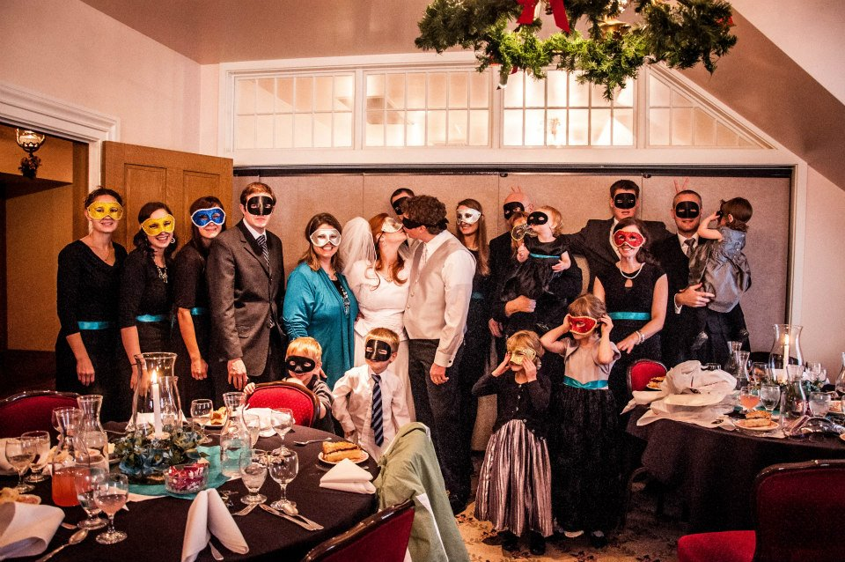
About Mrs. Cox
I grew up in Taylorsville, Utah.
I am the 5th of 7 children.
I have four brothers and two sisters.
I have my Bachelor’s degree from UVU and my Master’s from Emporia State (Librarian)

Slide 27
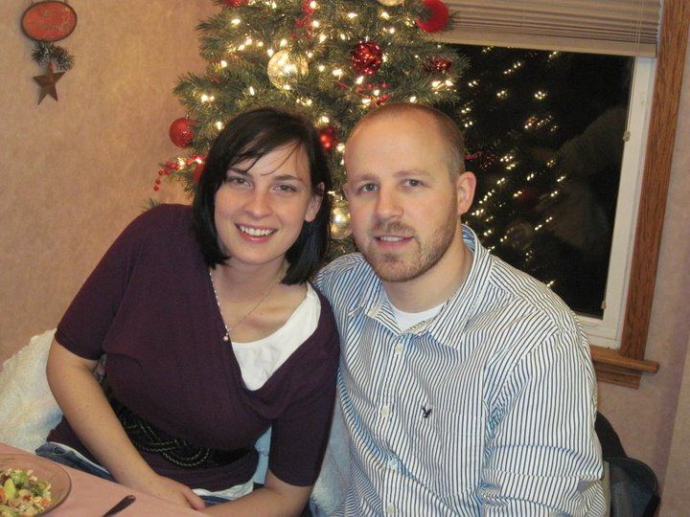
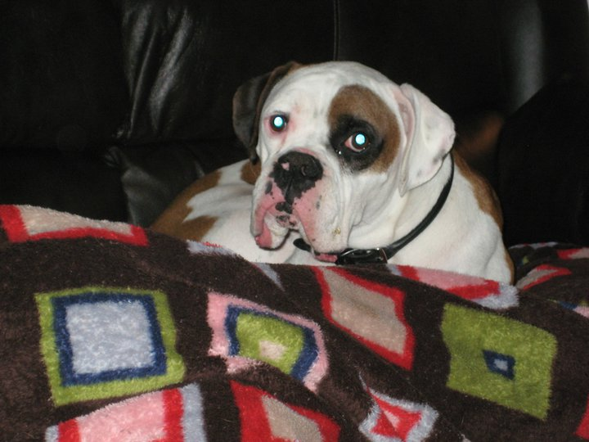



More about Mrs. Cox
I am married.
I have 0 kids.
I have a dog. He is a boxer. His name is Julio.
This is my seventh year teaching.
I read 56 books in 2015 and have a goal to read the same in 2016.

Slide 28
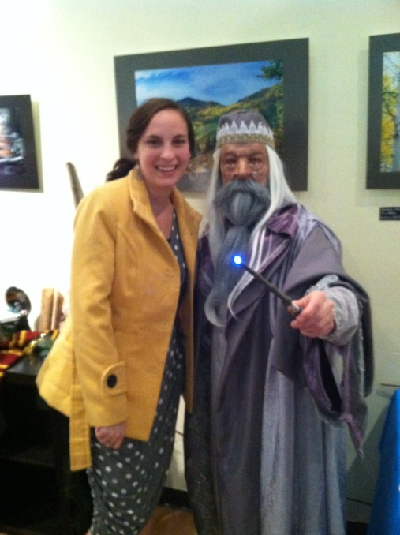

More about Mrs. Cox
I’m a big Kansas Jayhawks basketball fan. (Therefore I do not follow BYU or U of U).
I’m a big Harry Potter fan.

Slide 29
Would You Rather
1. Start with the tallest person at your table.
  a. Pick one of the questions on the list.
  b. Everyone answers the question by first stating their name, “I, Mrs. Cox, would rather _______ than ________ because _____________.
2. Move clockwise to the next person.
c. Repeat a & b
3. Repeat until you have asked every question on the paper.

