Slide 1
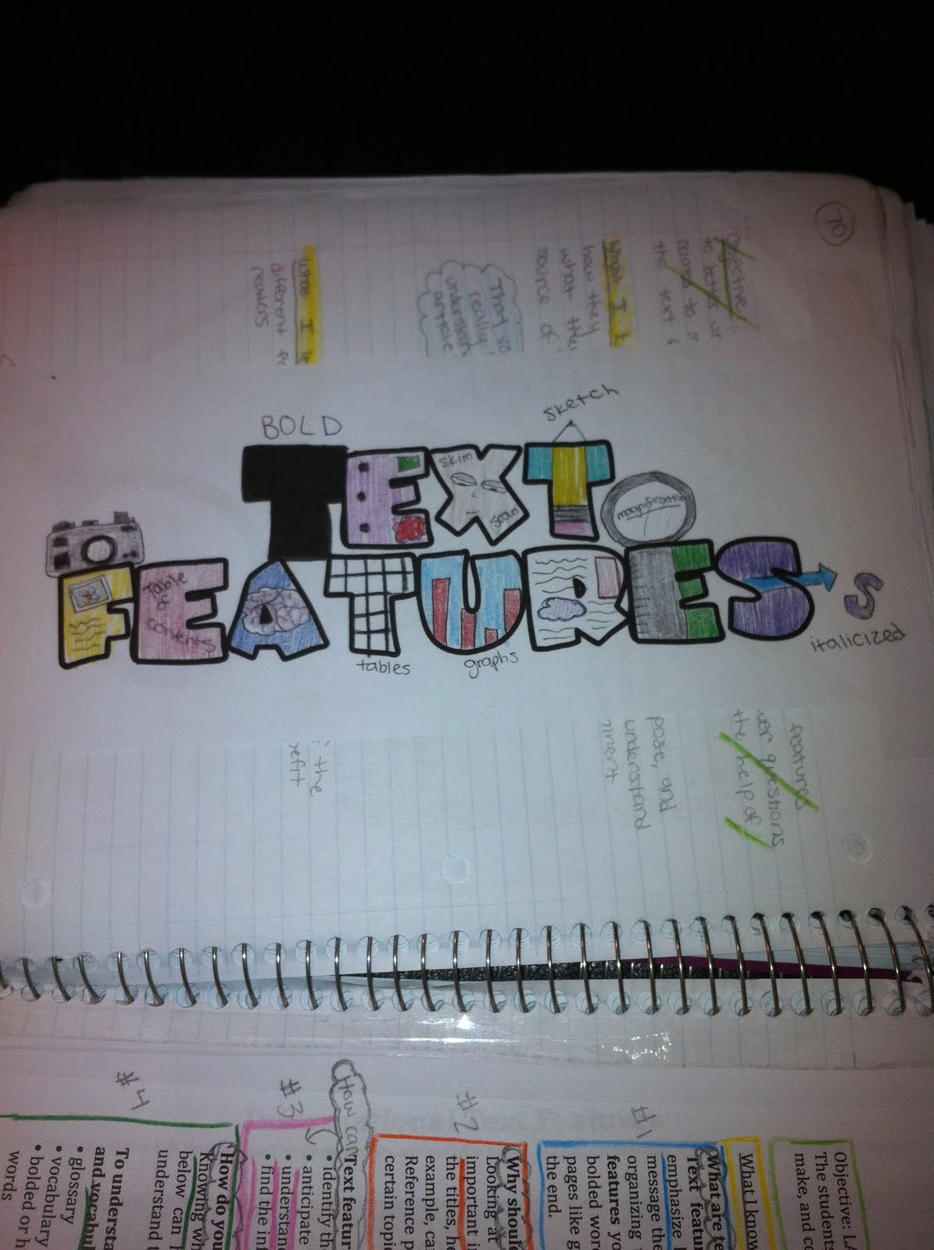

Slide 2
Text Features
To be honest, I hate talking about them.

Slide 3
Headings & Subheadings
SPORTS TEAMS I DON’T LIKE
Los Angeles Lakers
The Lakers seem to always eliminate the Utah Jazz from the playoffs. Also, the players on their team are pompous and arrogant (they pontificate).
Kansas State
I am jealous they have such a great football program compared to Kansas but just like the Utes, they steal their slogans from other schools.
New York Yankees
Because of the MLB ill-conceived collective bargaining agreement, the Yankees can nearly spend their way to the world series every year.

Slide 4
Pictures & Captions
Caption

Slide 5
SideBars
Sidebar

Slide 6
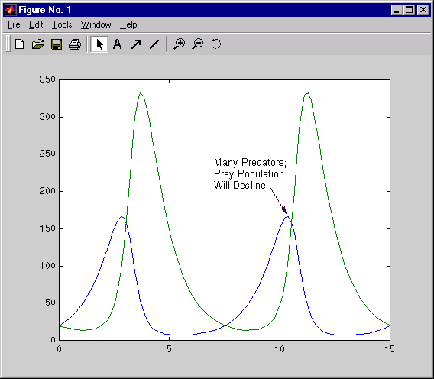
Annotations
a critical or explanatory note or body of notes added to a text.
Annotation

Slide 7
Italics & Bolded Words
Italics are used to refer to the word itself and not the actual thing that the word represents.
I don’t know how to spell the word regardless unless I use spell checker.
Bolded words are used to show importance.
Canines are dogs.

Slide 8
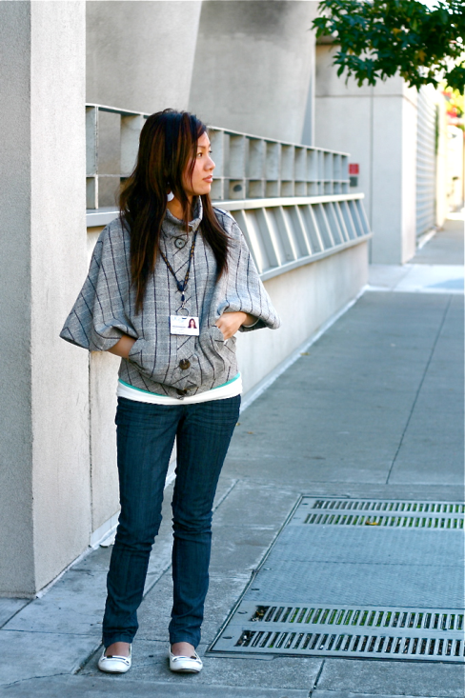
Graphs

Slide 9
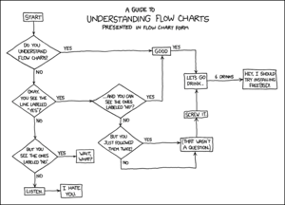
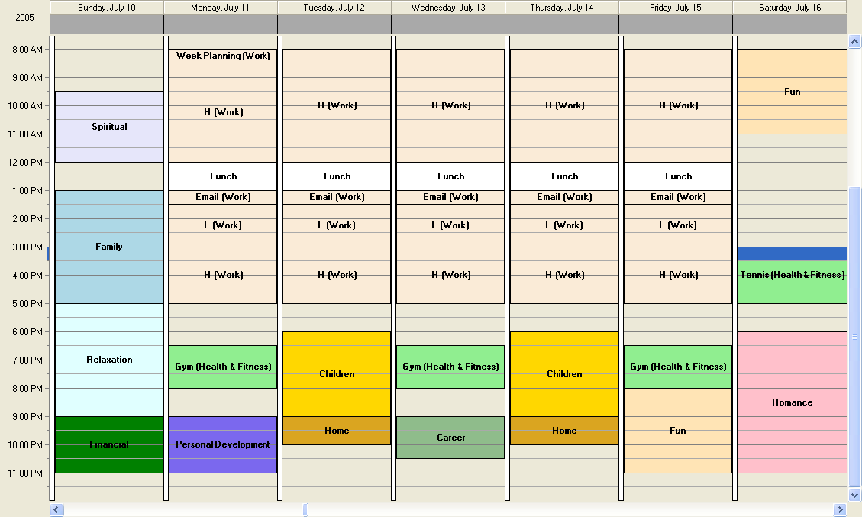
Charts

Slide 10
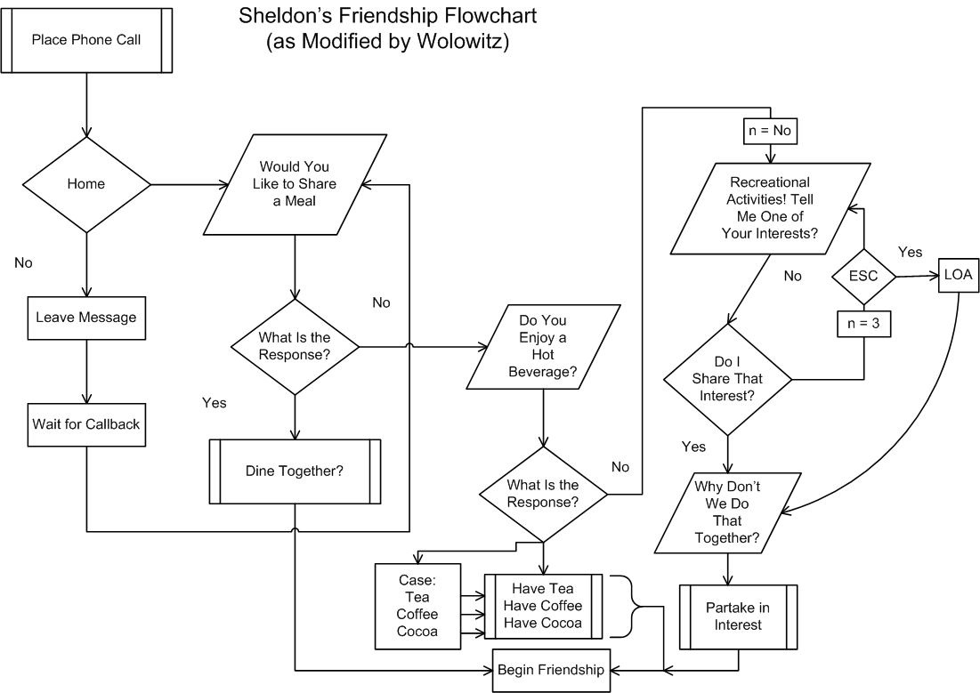

Slide 11
Table Of Contents

Slide 12
Glossary (Used like a dictionary, but it is in the back of books.)

Slide 13
Index (Used to Look up certain topics to find out what page they are on.)

