Slide 1
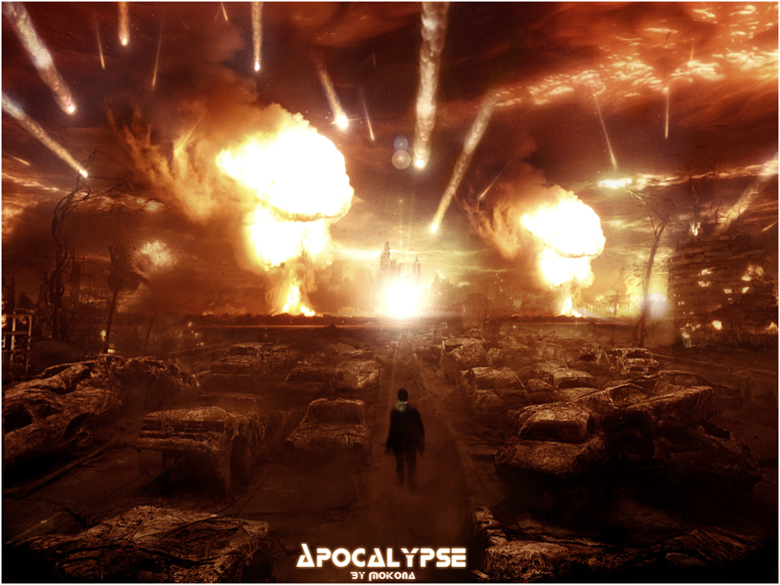
Welcome to the apocalypse.
Survival is more important than anything else.

Slide 2
The Situation.
Congratulations. You all are the only survivors of an alien attack.
The aliens are still searching for any surviving humans.
Somehow you have escaped, but you need to figure out how to survive.
I did not survive. You must figure this out on your own.

Slide 3
What you have/need.
You have technology and science. You managed to save the most advanced technologies.
You need to figure out a way to survive.
You need more food.
You need shelter.
You need more humans QUICKLY—your technology can help.
You need those humans to be stronger and smarter than the average human.

Slide 4
Create a new society.
Rebuild your society with the knowledge and technology you have.
How will you get/make food?
How will you get shelter for survivors and cloned humans?
Who will raise the cloned humans?
How will the cloned humans be regulated?
How will they be trained to help defend you against the aliens?
Who will be in charge of all of the humans?
What are your laws?
Remember—survival is your goal.

Slide 5
Groups
Include:
Government
Plans for food and shelter
Plans for increasing the human population QUICKLY using science and technology (cloning and enhancement).
Plans for how to regulate the clones and use them to help survive.
How will you defend yourselves against the alien enemy (describe them)?
What rights do original survivors have?
What rights do clones have?
BE DETAILED IN YOUR PLANS
Your group will present their plan on Nov. 9 & 10. We will vote on the best option.

